Slide 1
Domain Specific Knowledge for Large Language Models
Ameen Izhac, Pedro M. Baiz V, Marek Rei, MEng Individual Project

Slide 2
Motivation

Slide 3
Large Language Models are

Slide 4
Large Language Models are
Intelligent

Slide 5
Large Language Models are
Intelligent
Creative

Slide 6
Large Language Models are
Intelligent
Creative
Big liars

Slide 7
Applications

Slide 8
Applications
Energy regulations

Slide 9
Applications
Energy regulations
Legal information

Slide 10
Applications
Energy regulations
Legal information
Medical information

Slide 11
Tackling the Problem

Slide 12
Tackling the Problem
We can either

Slide 13
Tackling the Problem
We can either
Teach an LLM to say “I don’t know” [1]
[1] Sanyam Kapoor, Nate Gruver, Manley Roberts, Katherine Collins. Large Language Models Must Be Taught to Know What They Don't Know. 2024

Slide 14
Tackling the Problem
We can either
Teach an LLM to say “I don’t know” [1]
Make sure the LLM knows
[1] Sanyam Kapoor, Nate Gruver, Manley Roberts, Katherine Collins. Large Language Models Must Be Taught to Know What They Don't Know. 2024

Slide 15
Requirements

Slide 16
Requirements
Comprehension

Slide 17
Requirements
Comprehension
Communication

Slide 18
Requirements
Comprehension
Communication
Knowledge

Slide 19
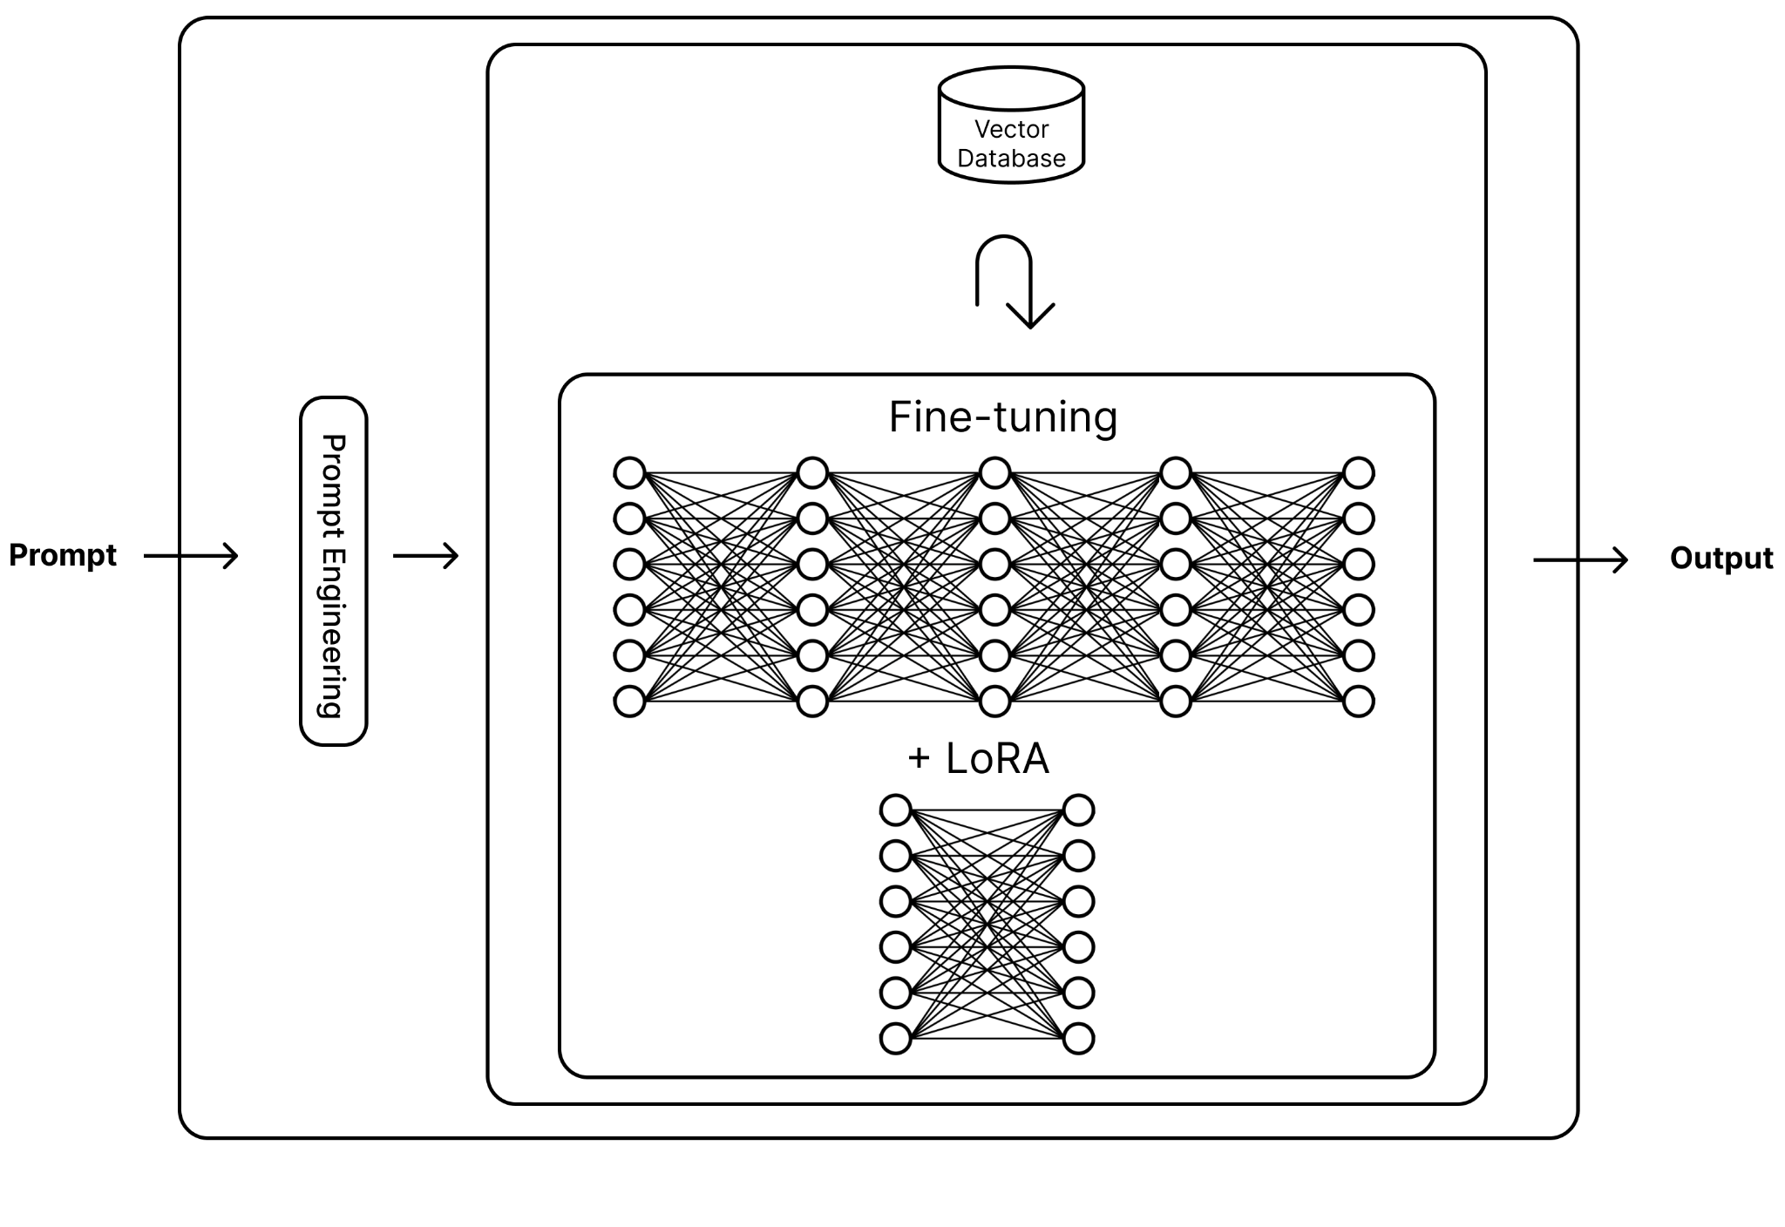

Slide 20
Overview
Flan-T5 Base evaluation encouraged adopting a bigger model
Llama 3 8B answering Closed Answer Anatomy Questions
Multiple Choice Evaluation
Improvement via Prompt Engineering and RAG

Slide 21
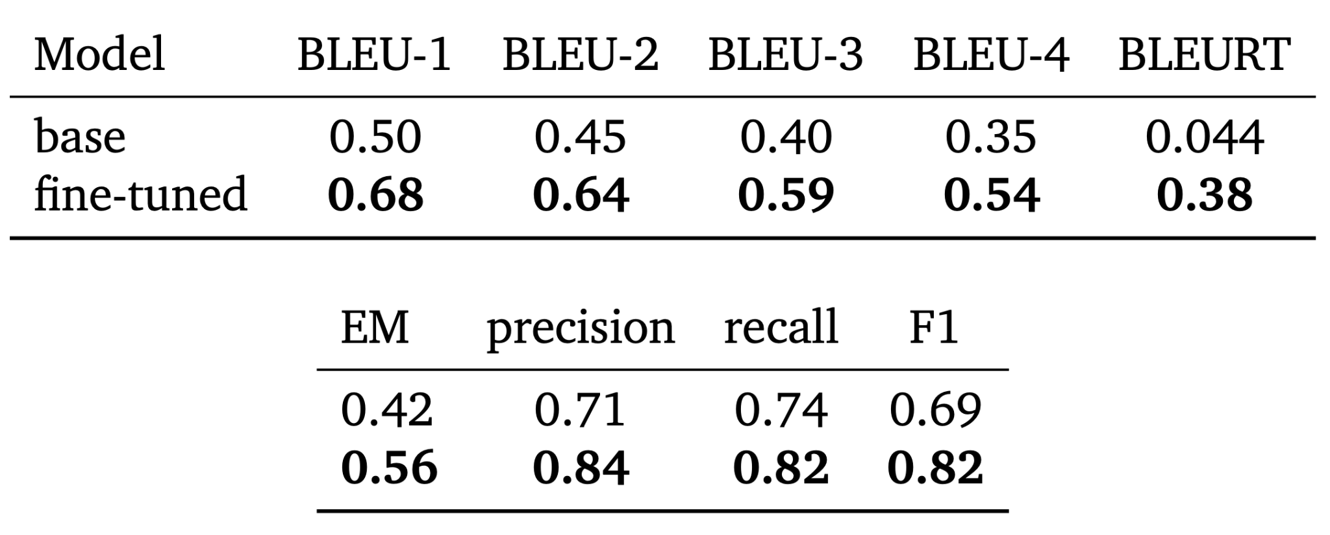
Flan T5 - CoQA
Have you ever been to some big cities in the world? The information below will be helpful to you. Budapest For many centuries...
Was Budapest always one city?
no
How many was it?
two

Slide 22
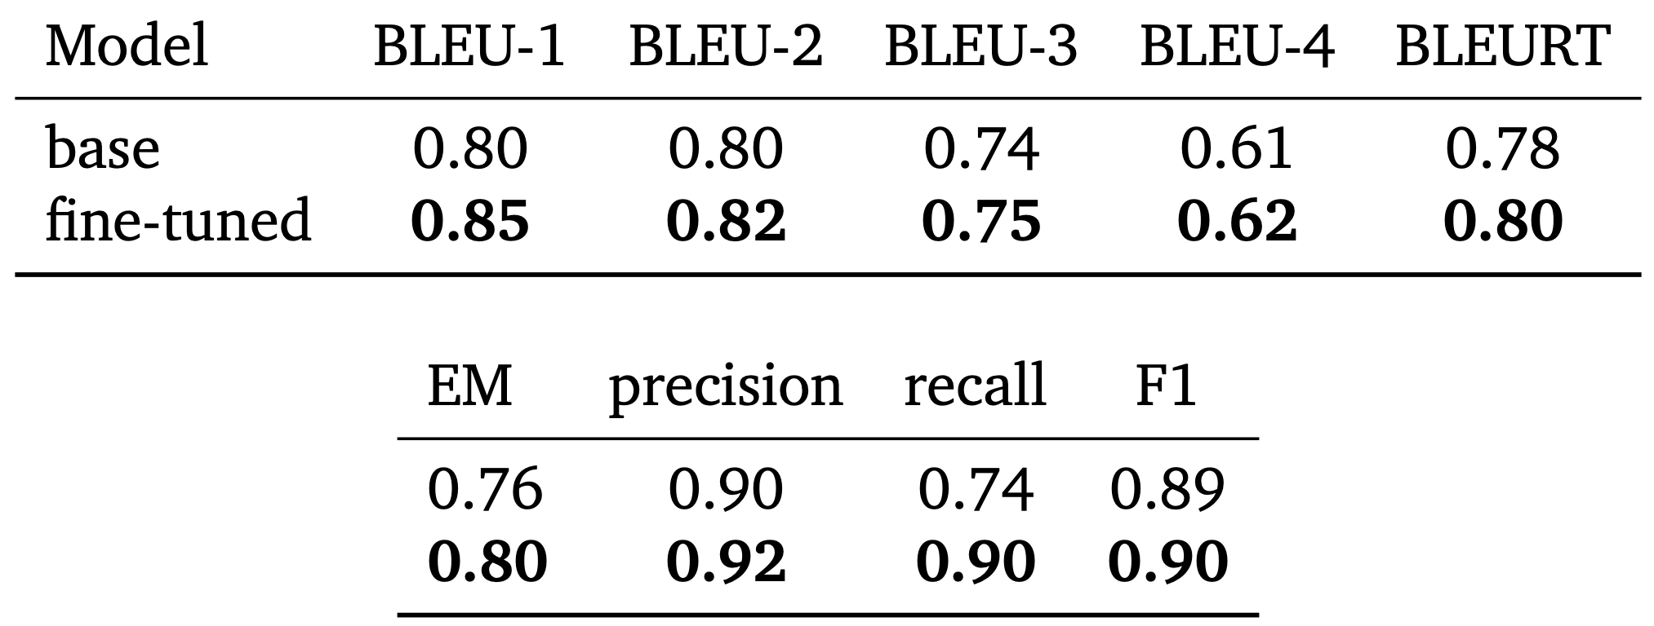
Flan T5 - SQuAD
Architecturally, the school has a Catholic character. Atop the Main Building's gold dome is a golden statue of the Virgin Mary. Immediately in front of the Main Building...
To whom did the Virgin Mary allegedly appear in 1858 in Lourdes France?
Saint Bernadette Soubirous

Slide 23
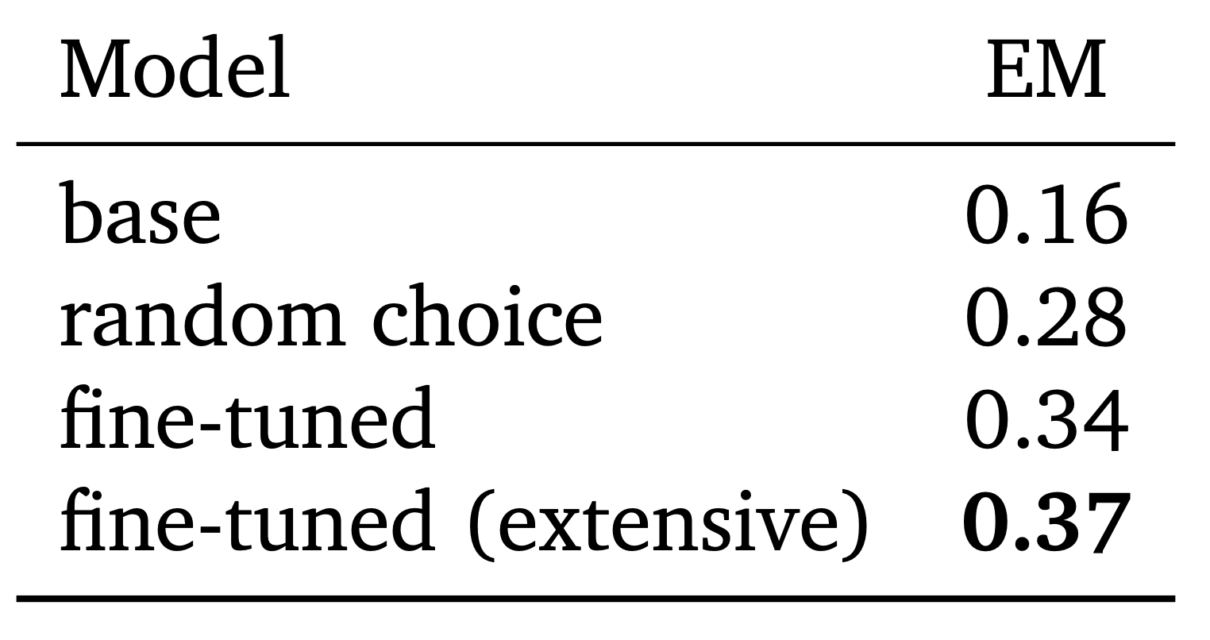
Flan T5 - MedMCQA
Chronic urethral obstruction due to benign prismatic hyperplasia can lead to the following change in kidney parenchyma
Hyperplasia
Hyperophy
Atrophy
Dyplasia
Atrophy

Slide 24
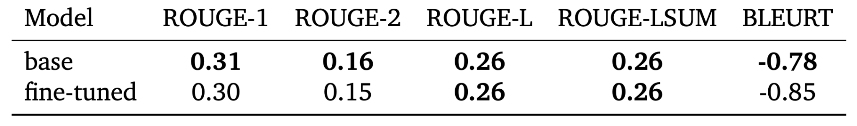
Flan T5 - CNN and Daily Mail
MINNEAPOLIS, Minnesota (CNN) -- Drivers who were on the Minneapolis bridge when it collapsed told harrowing tales of survival. "The whole bridge from one side of the…
NEW: "I thought I was going to die," driver says . Man says pickup truck was folded in half; he just has cut on face

Slide 25
Llama 3 8B

Slide 26
Results Table
Dataset | Llama 3 8B Base | Llama 3 8B Final
MedMCQA | 0.462 | 0.585 (12.3%)
MedMCQA-Anatomy | 0.534 | 0.632 (9.8%)
MedQA (USMLE) | 0.513 | 0.581 (6.8%)
PubMedQA | 0.722 | 0.436 (-28.6%)
MMLU-Anatomy | 0.474 | 0.578 (10.4%)
Multiple Choice - Exact Match

Slide 27
Prompt Engineering

Slide 28
Prompt Engineering
Few-Shot

Slide 29
Prompt Engineering
Few-Shot
Chain of Thought

Slide 30
Prompt Engineering
Few-Shot
Chain of Thought
System Prompting

Slide 31
Prompt Engineering
Dataset | Llama 3 8B Base | Llama 3 8B (PE)
MedMCQA | 0.462 | 0.517 (5.5%)
MedMCQA-Anatomy | 0.534 | 0.585 (5.1%)
MedQA (USMLE) | 0.513 | 0.573 (6.0%)
PubMedQA | 0.722 | 0.722 (0.0%)
MMLU-Anatomy | 0.474 | 0.578 (10.4%)
Few-Shot
Chain of Thought
System Prompting

Slide 32
RAG

Slide 33
RAG
MedMCQA Questions

Slide 34
RAG
Dataset | Llama 3 8B Base | Llama 3 8B RAG
MedMCQA | 0.462 | 0.585 (12.3%)
MedMCQA-Anatomy | 0.534 | 0.632 (9.8%)
MedQA (USMLE) | 0.513 | 0.581 (6.8%)
PubMedQA | 0.722 | 0.436 (-28.6%)
MMLU-Anatomy | 0.474 | 0.578 (10.4%)
MedMCQA Questions

Slide 35
RAG
Dataset | Llama 3 8B Base | Llama 3 8B RAG
MedMCQA | 0.462 | 0.585 (12.3%)
MedMCQA-Anatomy | 0.534 | 0.632 (9.8%)
MedQA (USMLE) | 0.513 | 0.581 (6.8%)
PubMedQA | 0.722 | 0.436 (-28.6%)
MMLU-Anatomy | 0.474 | 0.578 (10.4%)
MedMCQA Questions
Anatomy Textbook(s)

Slide 36
RAG
Dataset | Llama 3 8B Base | Llama 3 8B RAG
MedMCQA | 0.462 | 0.585 (12.3%)
MedMCQA-Anatomy | 0.534 | 0.632 (9.8%)
MedQA (USMLE) | 0.513 | 0.581 (6.8%)
PubMedQA | 0.722 | 0.436 (-28.6%)
MMLU-Anatomy | 0.474 | 0.578 (10.4%)
MedMCQA Questions
Anatomy Textbook(s)
Providing Definitions

Slide 37
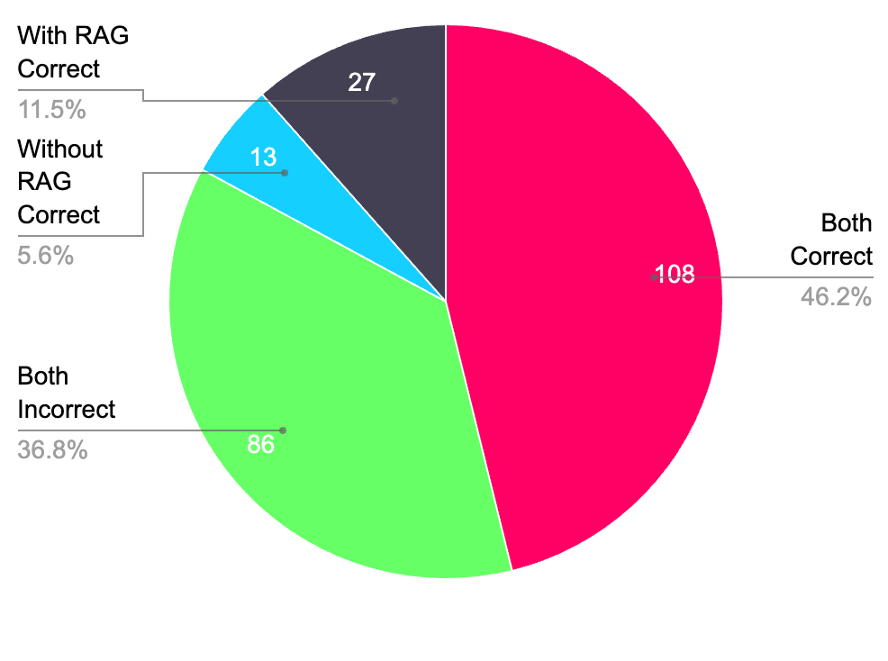
Impact of RAG

Slide 38
Impact of RAG
PubMedQA | 0.722 | 0.436 (-28.6%)

Slide 39
LoRA
Effective Batch Size | Samples | Learning Rate | LoRA Rank | LoRA Alpha | Exact Match
- | - | - | - | - | 0.585
128 | 4,000 | 2e-4 | 32 | 64 | 0.585
128 | 4,000 | 2e-4 | 64 | 128 | 0.585
128 | 4,000 | 2e-4 | 128 | 256 | 0.585
128 | 4,000 | 2e-4 | 256 | 512 | 0.585
128 | 3,500 | 1e-5 | 256 | 512 | 0.585
128 | 3,500 | 3e-5 | 256 | 512 | 0.585
128 | 4,000 | 5e-5 | 256 | 512 | 0.585
128 | 4,000 | 7e-5 | 256 | 512 | 0.585
128 | 4,000 | 9e-5 | 256 | 512 | 0.585
64 | 3,800 | 4e-5 | 64 | 128 | 0.585

Slide 40
LoRA
Effective Batch Size | Samples | Learning Rate | LoRA Rank | LoRA Alpha | Exact Match
64 | 3,800 | 1e-4 | 64 | 128 | 0.585
64 | 3,800 | 3e-4 | 32 | 64 | 0.585
128 | 4,000 | 5e-4 | 128 | 256 | 0.585
256 | 5,000 | 6e-4 | 128 | 256 | 0.585
128 | 4,000 | 2e-4 | 16 | 32 | 0.585
128 | 8,000 | 2e-4 | 16 | 32 | 0.585
128 | 14,560 | 2e-4 | 16 | 32 | 0.585

Slide 42
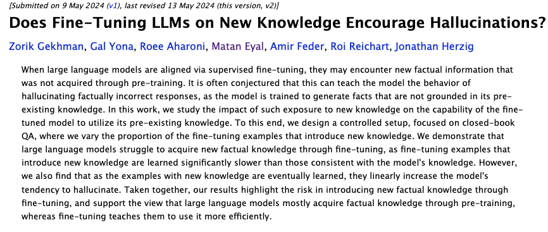

Slide 43
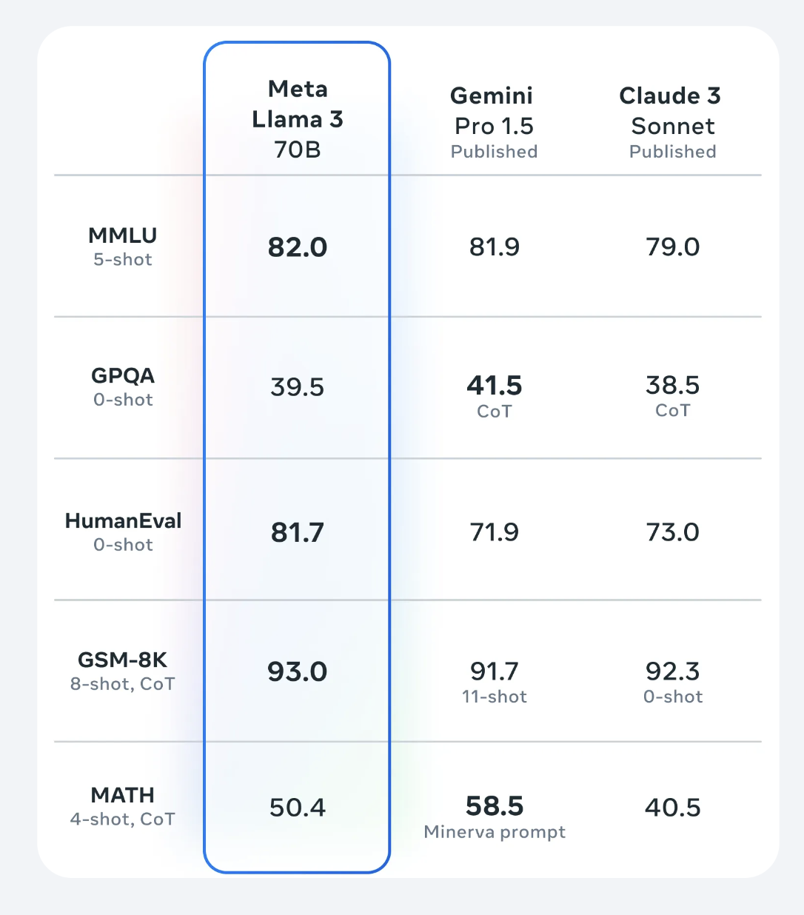
Second Opinion

Slide 44
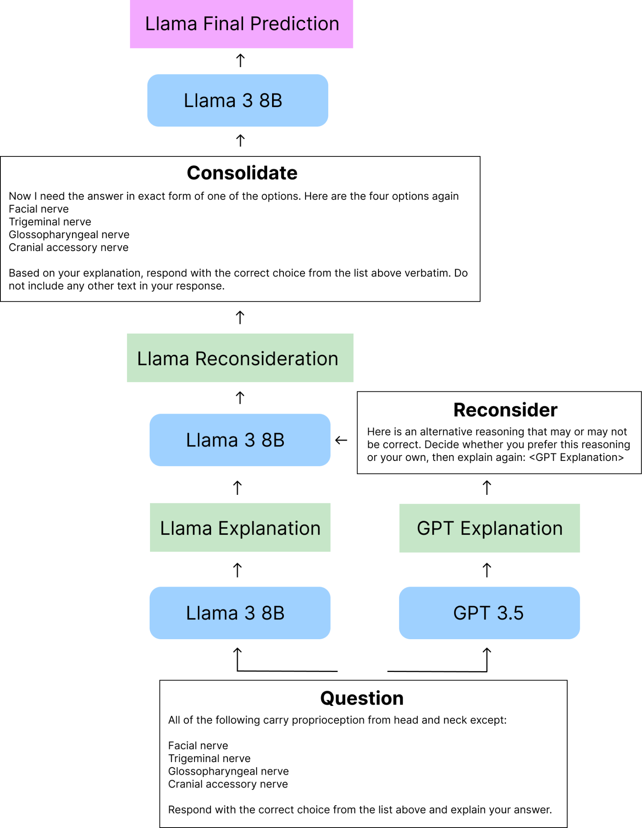
Second Opinion

Slide 45
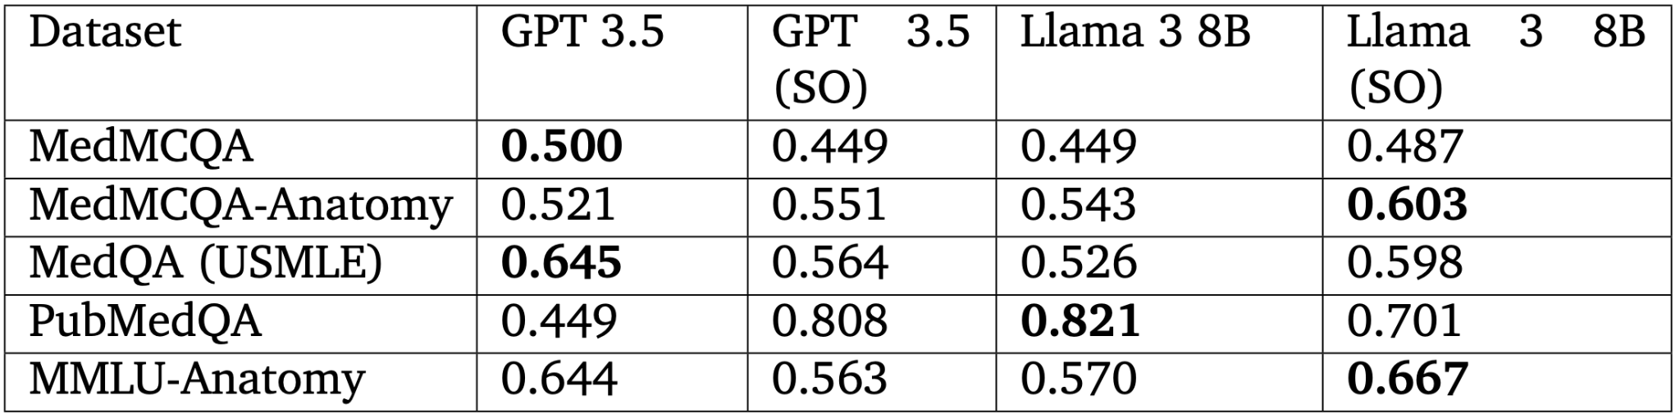
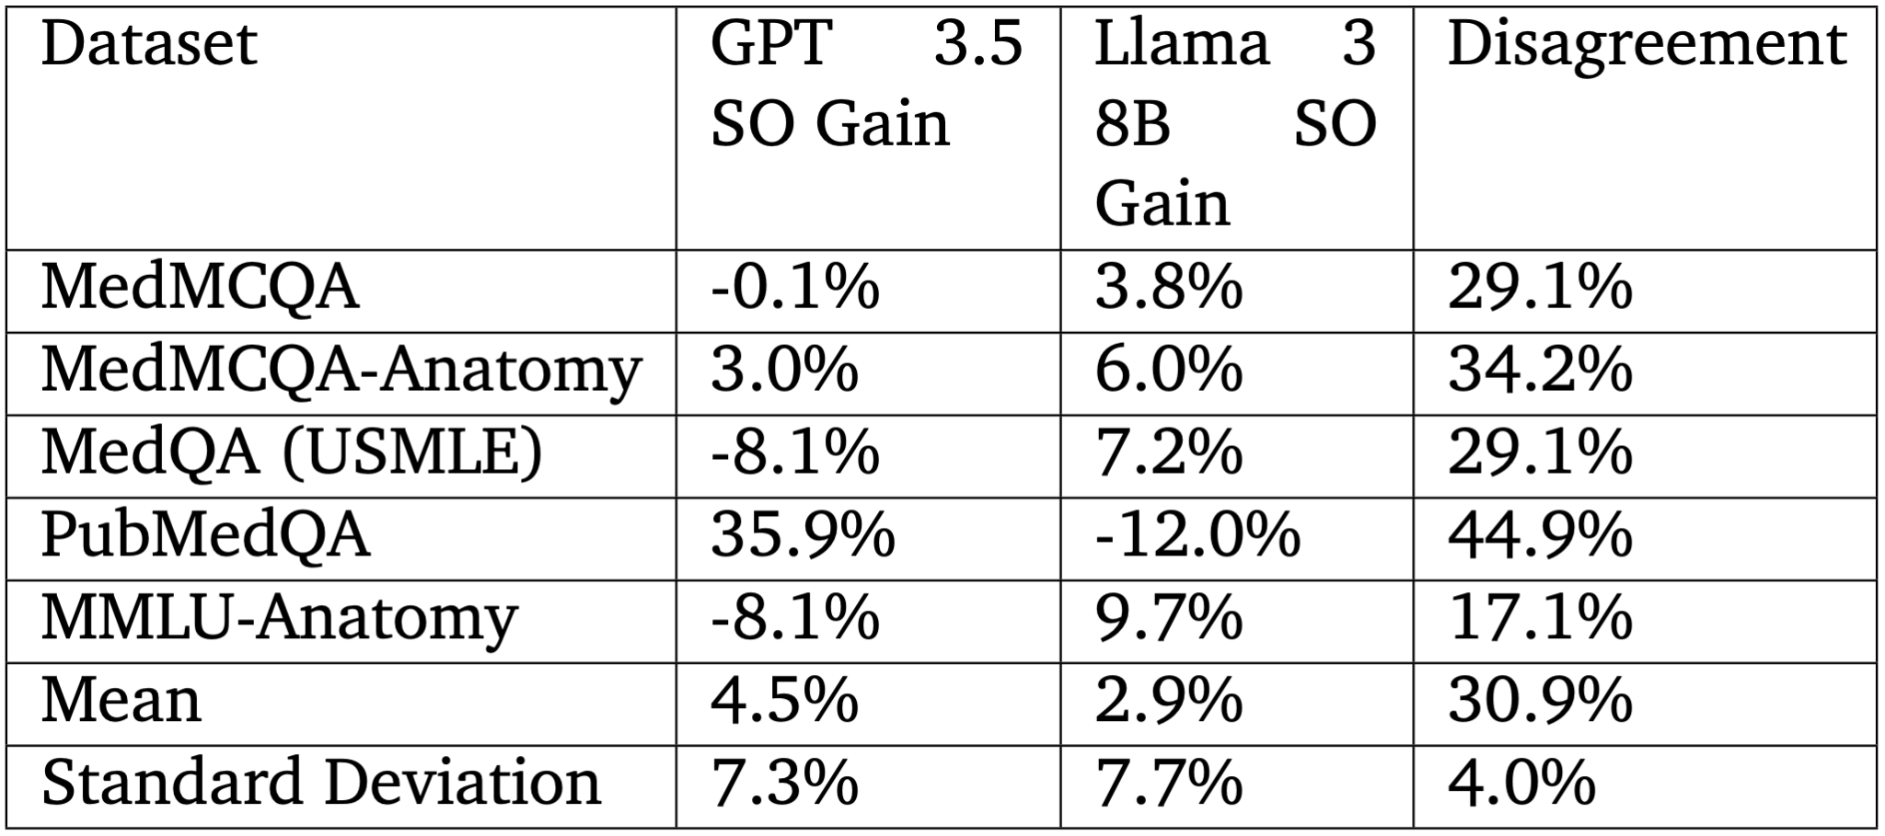
Second Opinion

Slide 46
Conclusion and Future Work
Custom Knowledge Base
Dynamic Knowledge Base
Long Answer Subdomain

